Slide 1
Consumer Protection Working Party Meeting Sponsor

Slide 2
Solvency II and Consumer Protection A view from Mexico
Topics to be addressed:
Brief description of Mexican insurance market
Introduction to the new Insurance and Surety Companies Law
Consumer protection in Mexico
Solvency II in Mexico
Equivalence under Solvency II
Conclusions

Slide 3
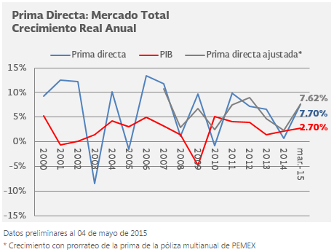
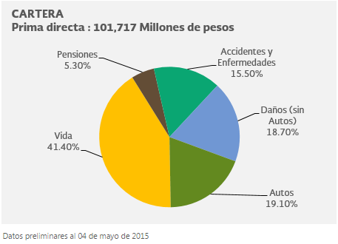
Brief description of Mexican insurance market

Slide 4
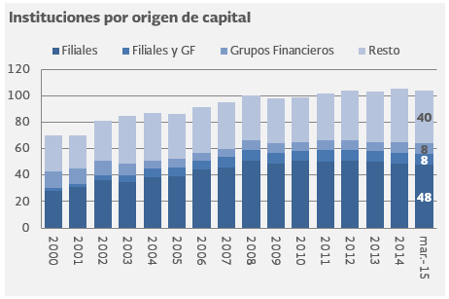
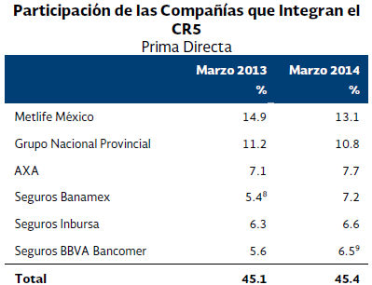
Brief description of Mexican insurance market

Slide 5
Introduction to the new Insurance and Surety Companies Law
General Law of Insurance and Mutual Companies and the Insurance Contract Law (1935 to 2013)
Insurance and Surety Companies Law (LISF):
Incorporate principles of Solvency II
New line of insurance denominated ‘surety insurance’ seguro de caución
More authorities granted to the National Insurance and Bonding Commission
Replacement of the Statutory Examiner with an Audit Committee
New framework for the creation of self-regulatory bodies for the development of the industry
New framework for the liquidation and dissolution of insurance and surety companies
Allow insurance companies to carry out securities operations known as ‘securitisations’

Slide 6
Consumer protection in Mexico
The National Insurance and Bonding Commission (CNSF)
Insurance products registration
Basic standardized insurance products
The National Commission for the Protection and Defence of Users of Financial Services (Condusef)
Alternative Dispute Resolution
Claims filed with the Condusef
Standard Contracts Registry
Insurance companies
Consultation and claims department

Slide 7
Solvency II in Mexico
Pillar I. Financial Requirements (will enter into effect from 1 January 2016)
Internal ad hoc actuarial model (Self regulation option)
Internal policy for monitoring its solvency, operations and investments
Investment policy
Technical reserves
Pillar II. Governance and Supervision
Corporate governance and new authorities of the board of directors
The Audit Committee
New accounting provisions
External financial and actuarial auditors
Regularization plans and self-correction programmes
Control measures
Interventions
License revocation
Liquidation and bankruptcy
Pillar III. Reporting and Disclosure

Slide 8
Equivalence under Solvency II
First third country equivalence decisions under Solvency II: Switzerland, Australia, Bermuda, Brazil, Canada, Mexico and the USA
The equivalence decision concerning Australia, Bermuda, Brazil, Canada, Mexico and the USA was granted for granted for a period of 10 years .
There are three distinct areas for equivalence evaluation of third countries under Solvency II:
Solvency calculation (article 227 of Solvency II): This is of relevance to EU insurers operating in a third country. If an EU insurer is active in a third country which is deemed equivalent, it can carry out its EU prudential reporting for a subsidiary in that third country under the rules of the third country, instead of Solvency II rules.
Group supervision (article 260 of Solvency II): This is of relevance to insurers from third countries with activities in the EU. If the third country's rules are deemed equivalent in this area, they are exempted from some aspects of group supervision in the EU.
Reinsurance (article 172 of Solvency II): This is of relevance to reinsurers from third countries. If the third country's rules are deemed equivalent, they must be treated by EU supervisors in the same way as they treat EU reinsurers.
These decisions now need to pass to the European Parliament and the Council for scrutiny

Slide 9
Summary
Premiums in Mexico have been growing consistently in the last years and there is still a lot of potential. However, penetration is very low.
The entry into effect of the LISF imply a number of important changes to Mexican insurance regulation, including Solvency II regulation and new measures for consumer protection.
Mexican regulation for insurance consumer protection is sufficient and work effectively.
Implementation of regulation equivalent to Solvency II in Mexico is proving to be challenging for the regulator and the market. At this point in time, the market is in a process of adaptation.
The equivalence decision of the European Commission on 5 June 2015, reassure that implementing Solvency II in Mexico will bring dynamism and flexibility to the Mexican insurance market without weakening the control measures and consumer protection.

